Slide 1
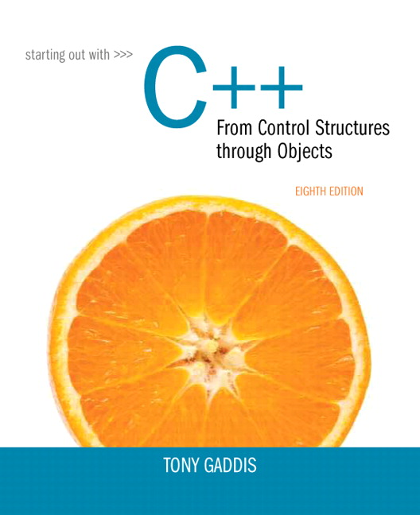
Chapter 2:
Introduction
to
C++

Slide 2
Section 2.2
Write a program that prints out “Programming is fun!”.
Make it print one word per line using ‘\n’ and/or endl.
Try splitting the output in different places, even within a word.
Try some other escape sequences and see how they perform:
‘\t’
‘\a’
‘\b’
‘\”’
Write a program that prints someone’s name with double quotes and/or single quotes appearing in the output.

Slide 3
Section 2.3
Checkpoint p. 36-37.
Locate the object file created by your compiler.
In VS 2013 is it found in the <project>\<project>\Debug folder.
Look for the exe file created by your compiler.
In VS 2013 it is found in the <project>\Debug folder.
Double click on that file through Windows Explorer and see what happens.

Slide 4
Section 2.4
Checkpoint p. 40.
Practice creating variables, like the int defined in Program 2-9. Give the variables different values and print out the results.

Slide 5
Section 2.5
Practice creating variables that do not fit the rules for identifiers. (For example, use characters in the name that are not allowed (e.g., ‘*’), or begin an identifier with a number.)
See what the compiler does.

Slide 6
Section 2.6
Checkpoint p47.
Execute the following statements in a C++ program short int sInt = 32767; cout << endl << “Value of sInt before add: “ << sInt << endl; sInt = sInt + 1; cout << endl << “Value of sInt after add: “ << sInt << endl; What do you think is going on here? (See slide 41)
Continue on next slide.

Slide 7
Section 2.6
Execute the following statements in a C++ program unsigned short int sInt = 0; cout << endl << “Value of sInt before add: “ << sInt << endl; sInt = sInt - 1; cout << endl << “Value of sInt after add: “ << sInt << endl; What do you think is going on here? (See slide 41)
Instead of 1, try adding or subtracting 2 or some other value to the original variable (that has been initialized to a boundary value). What is the result?

Slide 8
Section 2.7
Take Program 2-14 and change the letters that are being printed out to something different.
Modify Program 2-14 to print out the word “Happy” one character at a time, but with the entire word on one line.
Modify Program 2-14 to print out the word “Happy” one character at a time but with a space between each letter (and printed on one line).
Change the output statement on line 10 to: cout << static_cast<int> (letter) << ‘\n’; and see what happens. Compare the number that is printed out against the ASCII value for that letter.
If used as an integer, is the char data type signed or unsigned?

Slide 9
Section 2.8
Checkpoint p 53
Take a look at the charts on pp 588 – 589 of the text. These list some of the member functions that can be used with the string class.
Practice using some of these on a string of your choosing. For example, you might do string name = “Chuck Norris”; cout << “length = “ << name.length() << endl; to test the length function. Or, string name = “Chuck Norris”; cout << “first name = “ << name.substr(0,5) << endl; to test the substring function.
What statement would you need to print out “Norris” from the above string? Test your answer in a C++ program.

Slide 10
Section 2.9
Checkpoint p 59.

Slide 11
Section 2.10
Run program 2-17 and verify that a true value is printed as 1, a false value is printed as 0.
That is what happens when C++ is asked to report a boolean value. What about the other way around? What if we give C++ a numeric value and ask it to interpret that value as a boolean value? How does that work?
To answer that, put the following “if” statement in a C++ program: int x = 5; if (x) cout << “The value is true” << endl; else cout << “The value is false.” << endl; Try values for x that are positive (>0), negative (<0), and 0 and see what happens. Under what conditions does C++ interpret a number as true, as false?

Slide 12
Section 2.11
Use the sizeof() operator to determine the sizes the common numeric data types: int, long int, long long int, float, double, long double. Have those printed out to the screen.

Slide 13
Section 2.12
Note that the assignment operator also returns a value to the environment in which it was executed. Execute the following code and explain why the output statement executes: int x; if ( x = 5 ) cout << “hello” << endl;
Execute the previous code, but try a couple of other alternatives. Change the 5 to a -10 (a negative number). Does “hello” get printed out? Why or why not?
What about if x equals 0? Does “hello” get printed out? Why or why not?

Slide 14
Section 2.13
Execute Program 2-20 to verify that it won’t compile. Fix the problem and run it.

Slide 15
Section 2.14
Checkpoint p 69.
Execute with Program 2-25. Note that 125/ 60 will be printed out as 2 and not 2.083.
Change the 60 in line 14 to 60.0 and see what is printed out. Why is it still not 2.083?
Keeping the 60.0 in the denominator, re-declare minutes to be a double instead of an int, and see if that changes the answer to question 2.
Execute the calculation 2 * 3 – 2. Is the answer 4 (which it would be if the multiplication is done first), or is it 2 (if the subtraction is done first).

Slide 16
Section 2.16
Implement the Checkpoint on p73.
Write a program in which a const variable was not initialized in the declaration. What error message do you get?

